Slide 1


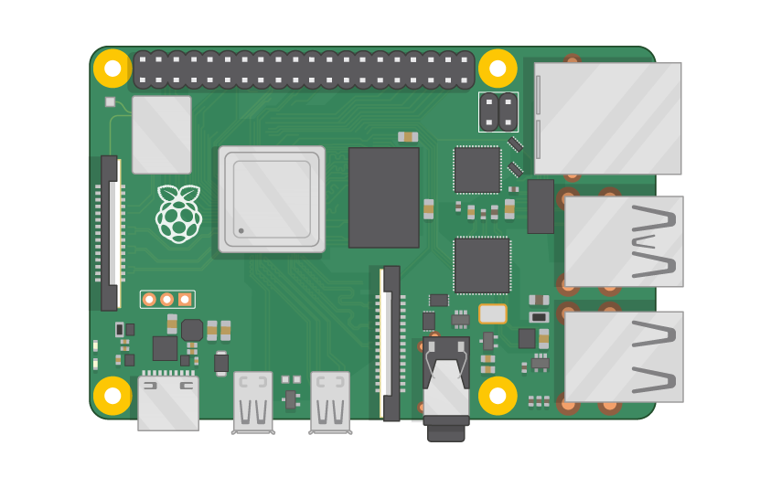
Raspberry Pi Master Class Day-6
Temperature & Humidity measurement using DHT11

Slide 2
Table of Contents
01
02
03
04
DHT11 Sensor
Installing DHT11 Library
Overview
Overview
Interface DHT11 Sensor
Discussion & Q&A
Temperature & Humidity measurement
Interractive session

Slide 3
PREREQUISITES FOR THIS COURSE
Raspberry Pi 3 Model b/B+
16 GB SanDisk class 10 SD Card
Card reader
Laptop with Internet
Power Adapter – 5V 2Amps
USB B-Type Cable
DHT11 Sensor

Slide 4
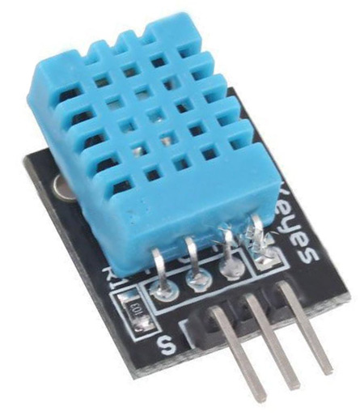
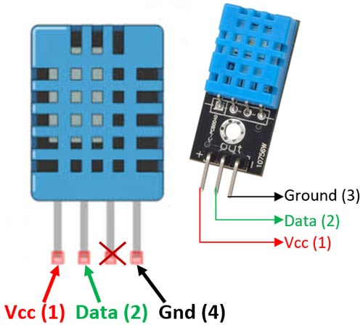
DHT11 Sensor
It uses a capacitive humidity sensor and a thermistor to measure the surrounding air, and spits out a digital signal on the data pin
Temperature Range: 0°C to 50°C
Humidity Range: 20% to 90%

Slide 5
Installing Libraries…
sudo apt-get install git-core
git clone https://github.com/adafruit/Adafruit_Python_DHT.git
cd Adafruit_Python_DHT
sudo apt-get install build-essential python-dev
sudo python3 setup.py install

Slide 6
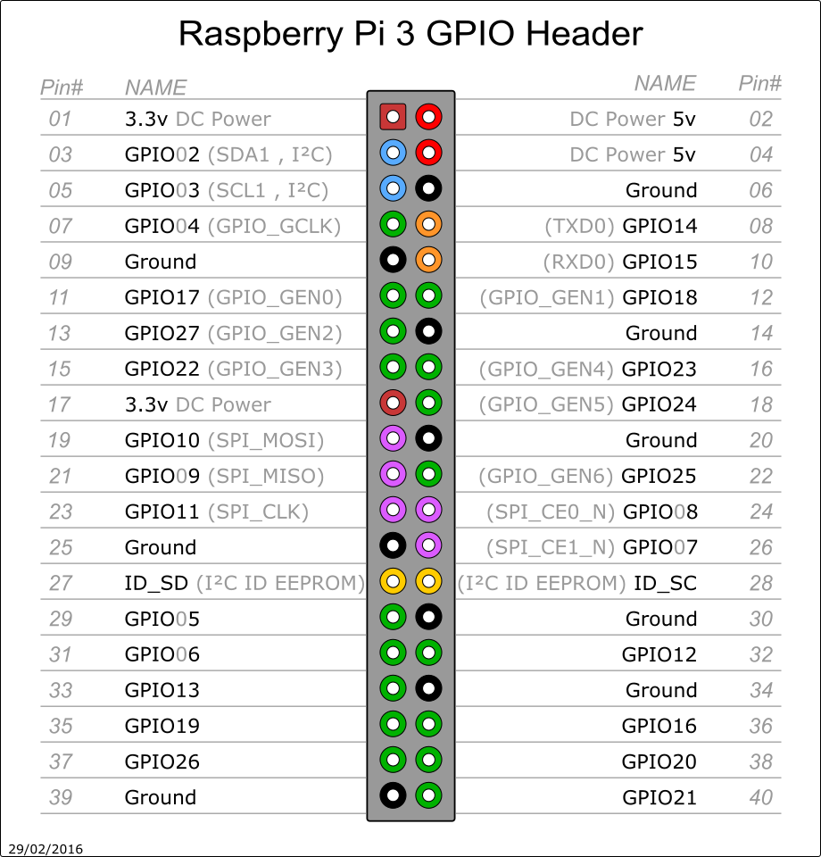
Pin Out of RPi3

Slide 7
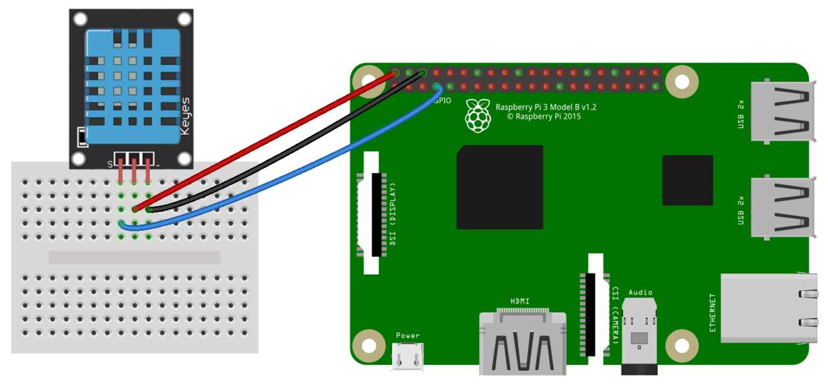
DHT11 with Rpi…

Slide 8
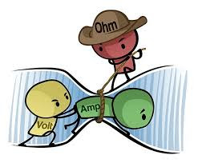

Q6 – Discussion
Understand Voltage and current
Sharp Knife as example
Current will kill u, but u need voltage to pass that current to flow on ur body so both needed.
Who is Killer Voltage or Current ?

Slide 9

Q7 – Discussion
Petrol vs Diesel Engine

Slide 10
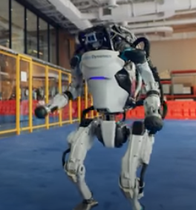
Boston Dynamics robots take over the dance floor in latest video
Tech News - 6
Dec - 2020
Boston Dynamics’ Atlas and Spot robots can do a lot of things: sprinting, gymnastic routines, parkour, backflips, opening doors to let in an army of their friends, washing dishes, and (poorly) getting actual jobs. But the company’s latest video adds another impressive trick to our future robotic overlords’ repertoire: busting sick dance moves.

Slide 11

Thanks!
learn.pantechsolutions.net
www.pantechsolutions.net
No great mind has ever existed without a touch of madness
-Aristotle

